Slide 1
Unit 5 Storage Management
Unit 5 Storage Management

Slide 2
File
A file is a named collection of related information that is recorded on secondary storage such as magnetic disks, magnetic tapes and optical disks.
In general, a file is a sequence of bits, bytes, lines or records whose meaning is defined by the files creator and user.

Slide 3
File Systems
Store information on disks in units called files
Files are persistent, and only owner can explicitly delete it
Files are managed by the OS
A File system is the data structure that an operating system uses to keep track of files on a disk or partition
Notes:
3

Slide 4
File Naming & Extensions
Each file is associated with a name
Name divided into 2 parts, first part the name and second part is the extension
On UNIX, extensions are not enforced by OS
However C compiler might insist on its extensions
These extensions are very useful for C
Notes:
4

Slide 5
File Attributes
A file’s attributes vary from one operating system to another but typically consists of these:
Name – only information kept in human-readable form
Identifier – unique tag (number) identifies file within file system
Type – needed for systems that support different types
Location – pointer to file location on device
Size – current file size
Protection – controls who can do reading, writing, executing(Access control info)
Time, date, and user identification – data for protection, security, and usage monitoring.(creation, last modification and last use)
Notes:
5

Slide 6
File Operations
A file is an abstract data type. The OS can provide system calls to Create, Write, Read, Reposition, Delete and truncate files. Six basic operations on files are
Creating a file
Writing a file
Reading a file
Reposition within a file (file Seek)
Deleting a file
Truncating a file---erase the content of a file
Notes:
6

Slide 7
Info Associated with File Open
File pointer
File Count / Link Count
Disk location of the file
Access rights & locks
Notes:
7

Slide 8
File Types
Executable
Object
Source Code
Batch
Text
Library
Print or view
Archive
Multimedia

Slide 9
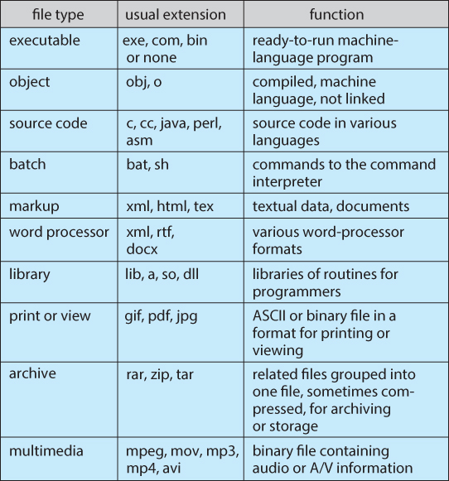

Slide 10
File Structure
A File Structure should be according to a required format that the operating system can understand.
A file has a certain defined structure according to its type.
A text file is a sequence of characters organized into lines.
A source file is a sequence of procedures and functions.
An object file is a sequence of bytes organized into blocks that are understandable by the machine.
When operating system defines different file structures, it also contains the code to support these file structure.
Unix, MS-DOS support minimum number of file structure.

Slide 11
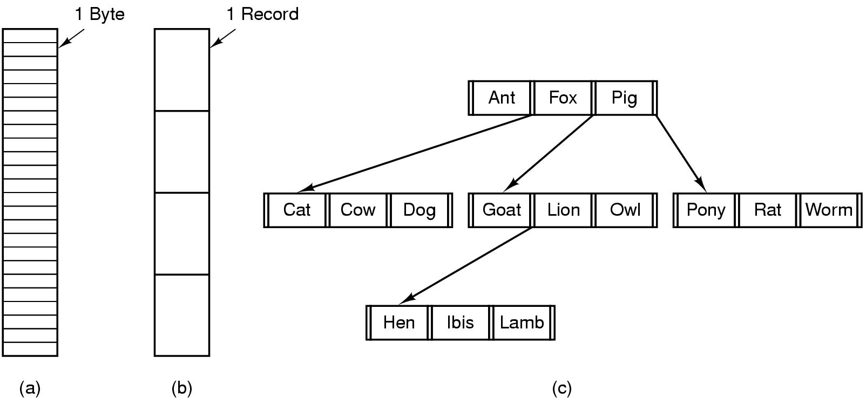
Internal File Structure
Byte Sequence: unstructured
Record sequence: r/w in records, relates to sector sizes
Complex structures, e.g. tree
- Data stored in variable length records; OS specific meaning of each file
Notes:
11

Slide 12
File Access Methods
Sequential access
Direct/Random access
Indexed sequential access

Slide 13
1.Sequential access
read all bytes/records from the beginning
cannot jump around, could rewind or forward
convenient when medium was magnetic tape
editors and compilers usually access files in this fashion
read next, Write next, Reset
Notes:
13

Slide 14
2. Random access
bytes/records read in any order
essential for database systems
Read(n) , Write(n), position to n [then uses readnext, writenext]
n represents the block number
Notes:
14

Slide 15
3. Indexed sequential access
This mechanism is built up on base of sequential access.
An index is created for each file which contains pointers to various blocks.
Index is searched sequentially and its pointer is used to access the file directly.

Slide 16
File System on disk
Could use entire disk space for a FS, but
A system could have multiple FSs
Want to use some disk space for swap space
Disk divided into partitions, slices or minidisks
Chunk of storage that holds a FS is a volume
Directory structure maintains info of all files in the volume
Name, location, size, type, …
Notes:
16

Slide 17
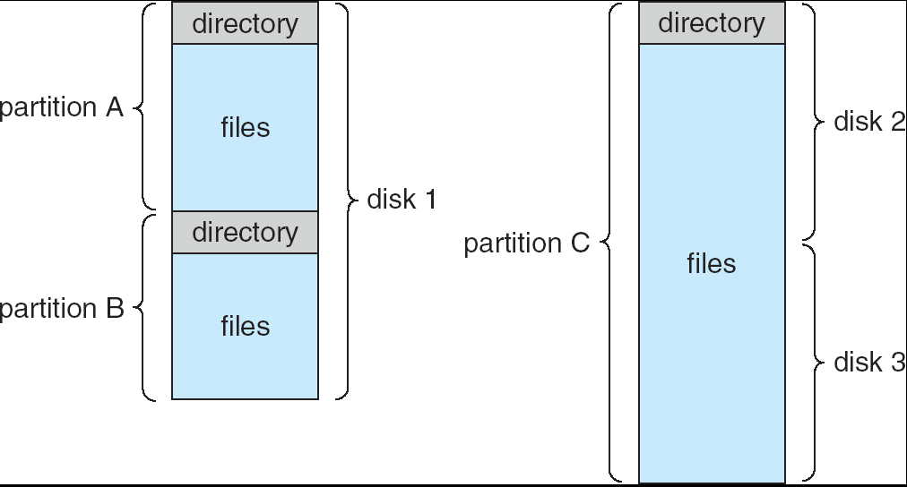
A typical file-system organization

Slide 18
Directory Overview
Directories/folders keep track of files
Is a symbol table that translates file names to directory entries
Usually are themselves files
Operations performed on a directory:
Search a file
Create a file
Delete a file
List directory
Rename a file
Traversing the FS
Notes:
18

Slide 19
Logical structure of a directory
The most common schemes for defining the logical structure of a directory
1. Single-level Directory
2. Two-level directory
3. Tree-structured Directory
4. Acyclic-Graph Directories

Slide 20
Single-level Directory
One directory for all files in the volume
Called root directory
Used in early PCs, even the first supercomputer CDC 6600
Pros: simplicity, ability to quickly locate files
Cons: inconvenient naming (uniqueness, remembering all)
Notes:
20

Slide 21
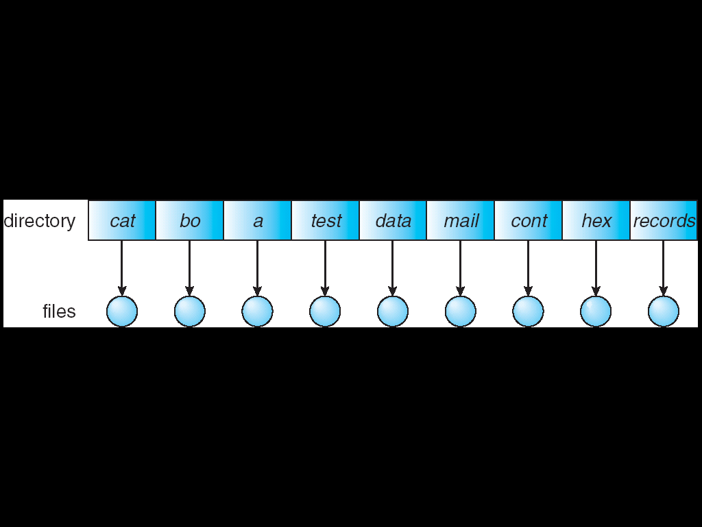
Single-level Directory
Used in early PCs, even the first supercomputer CDC 6600
Notes:
21

Slide 22
Two-level directory
Each user has a separate directory
Solves name collision, but what if user has lots of files
May not allow a user to access other users’ files
Notes:
22

Slide 23
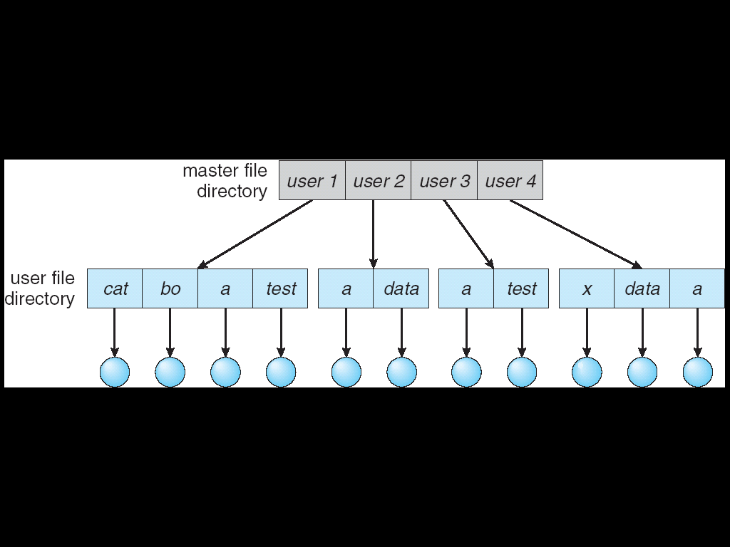
Two-level directory
Notes:
23

Slide 24
Tree-structured Directory
Directory is now a tree of arbitrary height
Directory contains files and subdirectories
A bit in directory entry differentiates files from subdirectories
Notes:
24

Slide 25
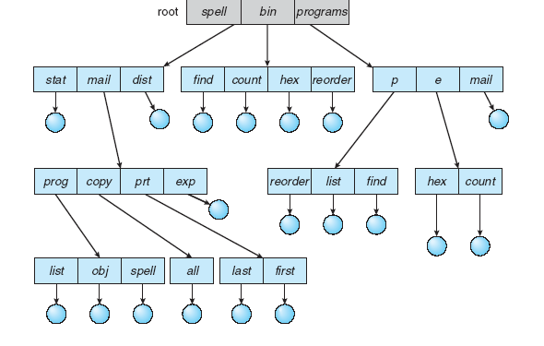
Tree-structured Directory
Notes:
25

Slide 26
Path Names
To access a file, the user should either:
Go to the directory where file resides, or
Specify the path where the file is
Path names are either absolute or relative
Absolute: path of file from the root directory
Relative: path from the current working directory
Notes:
26

Slide 27
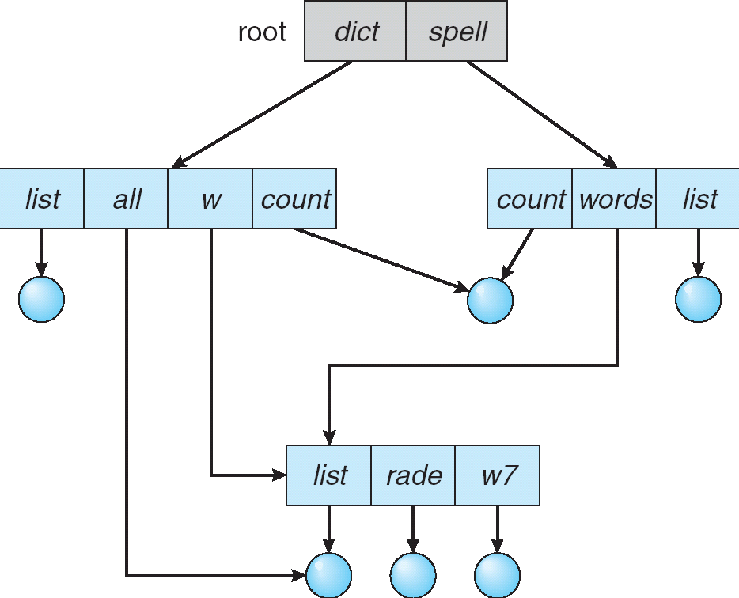
Acyclic Graph Directories
Share subdirectories or files
Notes:
27

Slide 28
File-System Structure
File Structure
Logical Storage unit
Collection of related information
File system is organized into layers
Notes:
28

Slide 29
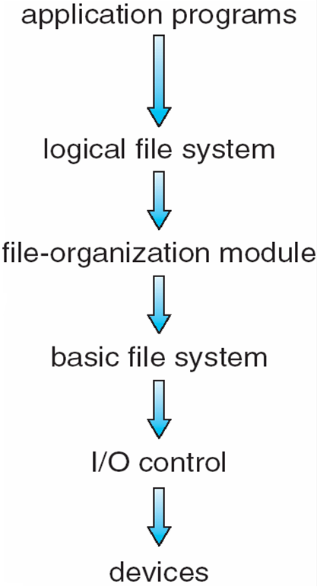
Layered File System
Notes:
29

Slide 30
File System Layers
Logical File System
Provides users the view of a contiguous sequence of words, bytes
Uses a directory structure, symbolic name
Provides protection and security
The file organization module
Knows about the files and the logical blocks
Files are organized in blocks of 32 bytes to 4k bytes
Translates logical blocks into physical

Slide 31
File System Layers
Basic File System
Issues commands to the device driver
Each physical block is identified by a disk address
I/O Control
The lowest level in the file system
Consists of device drivers and interrupt handlers to transfer information between the memory and the disk

Slide 32
Allocation Methods
An allocation method refers to how disk blocks are allocated for files:
1. Contiguous allocation
2. Linked allocation
3. Indexed allocation

Slide 33
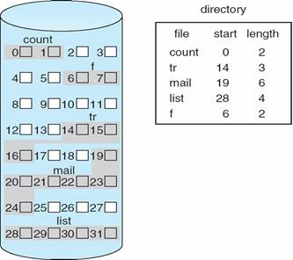
Contiguous Allocation
Notes:
33

Slide 34
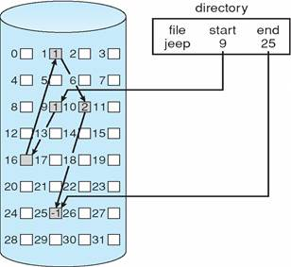
Linked Allocation
Notes:
34

Slide 35
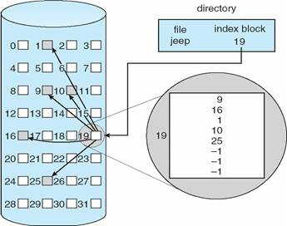
Indexed Allocation
Notes:
35

Slide 36
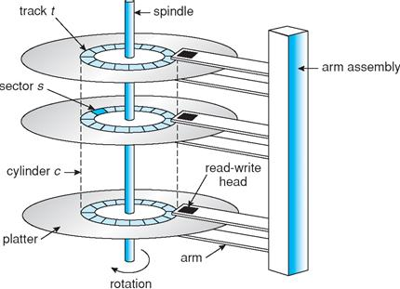
Overview of Mass Storage

Slide 37
Seek Time: Seek time is the time taken to locate the disk arm to a specified track where the data is to be read or write. So the disk scheduling algorithm that gives minimum average seek time is better.
Rotational Latency: Rotational Latency is the time taken by the desired sector of disk to rotate into a position so that it can access the read/write heads. So the disk scheduling algorithm that gives minimum rotational latency is better.
Transfer Time: Transfer time is the time to transfer the data. It depends on the rotating speed of the disk and number of bytes to be transferred.
Disk Access Time:
Disk Access Time =Seek Time+ Rotational Latency +Transfer Time

Slide 38
Disk Structure
Magnetic disks provide bulk of secondary storage of modern computers:
Drives rotate at 60 to 200 times per second
Transfer rate is the rate at which data flow between drive and computer
Positioning time is time to move disk arm to desired cylinder (seek time) and time for desired sector to rotate under the disk head (rotational latency)
Head crash results from disk head making contact with the disk surface
Disks can be removable

Slide 39
Disk Structure
Disk drives are addressed as large 1-dimensional arrays of logical blocks, where the logical block is the smallest unit of transfer
The 1-dimensional array of logical blocks is mapped into the sectors of the disk sequentially.
Sector 0 is the first sector of the first track
Mapping proceeds in order through that track, then the rest of the tracks in that cylinder and then through the rest of the cylinders from outermost to innermost.

Slide 40
Disk Scheduling Algorithms
The operating system is responsible for using hardware efficiently.
For the disk drives, this means having a fast access time & disk bandwidth.
Access time has two major components:
1.Seek time is the time for the disk arm to move the heads to the cylinder containing the desired sector.
2.Rotational latency is the additional time for the disk to rotate the desired sector to the disk head.
We like to minimize seek time.

Slide 41
Disk Scheduling Algorithms
Disk bandwidth is the total number of bytes transferred, divided by the total time between the first request for service and the completion of the last transfer.
Several algorithms exist to schedule the servicing of disk I/O requests.

Slide 42
Disk Scheduling
1.FCFS Scheduling
2.SSTF(Shortest-seek-time-First) Scheduling
3.SCAN Scheduling
4. C-SCAN (Circular SCAN)Scheduling
5.LOOK Scheduling

Slide 43
1.FCFS Scheduling
FCFS is the simplest of all the Disk Scheduling Algorithms.
In FCFS, the requests are addressed in the order they arrive in the disk queue.
Advantages:
Every request gets a fair chance
No indefinite postponement
Disadvantages:
Does not try to optimize seek time
May not provide the best possible service

Slide 44
FCFS
A disk queue with a Requests for I/O to blocks on cylinders (cylinder range 0-199):
98, 183, 37, 122, 14, 124, 65, 67
If the disk head is initially at cylinder 53
Illustration shows total head movement of 640 cylinders

Slide 45
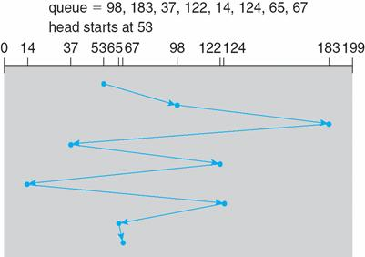
FCFS

Slide 46
2.SSTF(Shortest-seek-time-First) Scheduling
Selects the request with the minimum (least) seek time from the current head position.
SSTF scheduling may cause starvation of some requests
Illustration shows total head movement of 236 cylinders

Slide 47
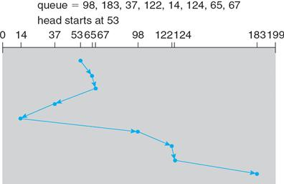
SSTF

Slide 48
3.SCAN Scheduling
The disk arm starts at one end of the disk, and moves toward the other end, servicing requests until it gets to the other end of the disk, where the head movement is reversed and servicing continues.
The head continuously scans back and forth across the disk. The SCAN algorithm is sometimes called the elevator algorithm.
Illustration shows total head movement of 208 cylinders
Notes:
236

Slide 49
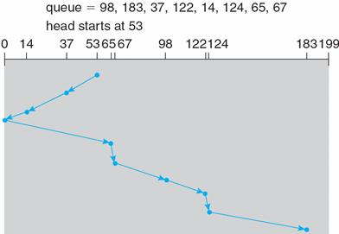
SCAN

Slide 50
4. C-SCAN (Circular SCAN)Scheduling
Provides a more uniform wait time than SCAN.
The head moves from one end of the disk to the other, servicing requests as it goes.
When it reaches the other end, however, it immediately returns to the beginning of the disk, without servicing any requests on the return trip.
Treats the cylinders as a Circular list that wraps around from the last cylinder to the first one
Ans--183

Slide 51
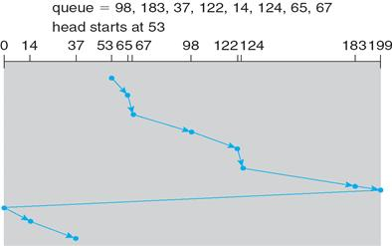
C-SCAN

Slide 52
5.LOOK Scheduling
LOOK scheduling improves upon SCAN by looking ahead at the queue of pending requests, and not moving the heads any farther towards the end of the disk than is necessary.

Slide 53
C-LOOK
Version of C-SCAN
Arm only goes as far as the last request in each direction, then reverses direction immediately, without first going all the way to the end of the disk.
153 Head movements

Slide 54
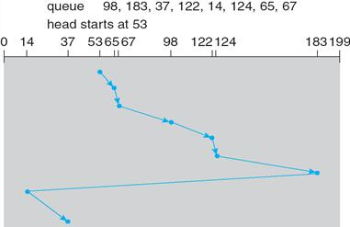
C-LOOK

Slide 55
Selecting a Disk-Scheduling Algorithm
SSTF is common and has a natural appeal
SCAN and C-SCAN perform better for systems that place a heavy load on the disk

Slide 56
Exercise Problem
Suppose that a disk has 5000 cylinders, numbered 0 to 4999. The drive is currently serving a request at cylinder 143, and the previous request was at cylinder 125. The queue of pending requests is:
86,1470,913,1774,948,1509,1022,1750,130
Starting from the current head position, what is the total distance that the disk arm moves to satisfy all the pending requests for the following disk-scheduling algorithms?
FCFS
SSTF
SCAN, C-SCAN, LOOK, C-LOOK

Slide 57
Protection
Protection refers to a mechanism for controlling the access of programs, processes, or users to the resources defined by a computer system.
Protection ensures that the resources of the computer are used in a consistent way.
It ensure that each object accessed correctly and only by those processes that are allowed to do so.

Slide 58
Goals of Protection
We need to provide protection for several reasons.
The most obvious is the need to prevent the mischievous, intentional violation of an access restriction by user.
An unprotected resource cannot defend against use (or misuse) by an unauthorized or incompetent user. A protection-oriented system provides means to distinguish between authorized and unauthorized usage.

Slide 59
Goals of Protection
Provide a mechanism for the enforcement of the policies governing resource use.
These policies can be established in a variety of ways.
- fixed in the design of the system
- formulated by the management of a system
- individual users
A protection system must have the flexibility to enforce a variety of policies.

Slide 60
Principles of Protection
The time-tested guiding principle for protection is the Principle of least privilege. It dictates that programs, users, and even systems be given just enough privileges to perform their tasks.
An operating system following the principle of least privilege implements its features, programs, system calls, and data structures so that failure or compromise of a component does the minimum damage and allows the minimum damage to be done.
The principle of least privilege can help produce a more secure computing environment.

